Slide 1
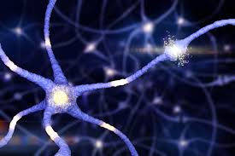
Classification des fleurs Iris
Algorithme du Perceptron
Mouhamadou GUEYE
Babacar MBATHE
Fallou DIOUF
Daouda FICKOU

Slide 2
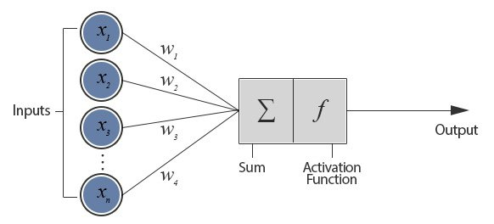
B
Introduction
Output
The final output is the result of the classification, which indicates to which class the input belongs. In our project, the output will be either 0 or 1, representing two different species of Iris flowers.
.
Inputs
The inputs of the Perceptron are the features of our data. In our case, these are the lengths of the sepals and petals of Iris flowers.
Net Input Function
The Perceptron calculates the net input by taking a weighted sum of the input features.
Activation Function
The activation function takes the net input and produces the output. In the Perceptron, the activation function is a threshold function that gives 1 if the net input is greater than or equal to zero, and 0 otherwise.
Weights
Each input feature is associated with a weight, which indicates the importance of the feature in making the classification. There is also a special weight called the bias, which allows us to shift the decision boundary.

Slide 3
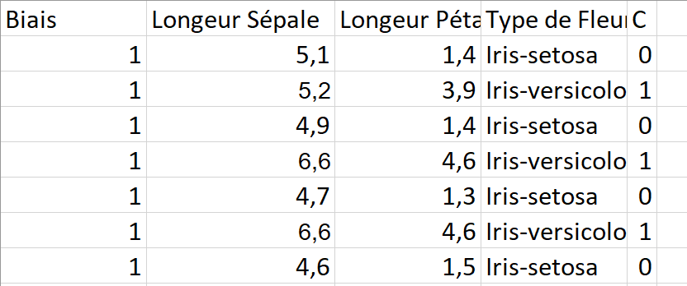
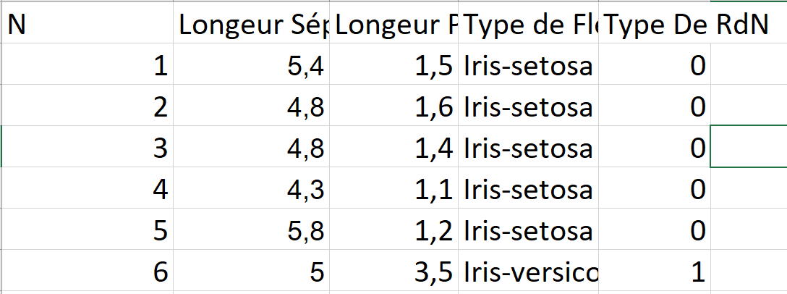
C
Problems et Objectif
1
Our main objective is to classify iris flowers into two categories (Iris-setosa and Iris-versicolor) using the lengths of sepals and petals.
2
We trained a perceptron model with a training database with the perceptron algorithm and tested this model with a test database with sepal and petal length to evaluate its performance.

Slide 4
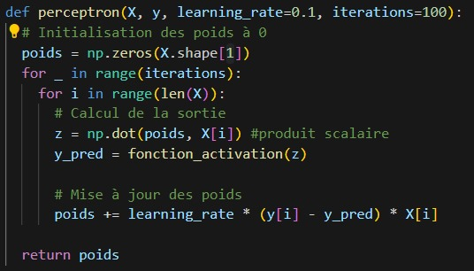



C
Solution
1
-Algorithm for determining weights
2
Weight after training
Predictions
Percentage of accuracy

Slide 5
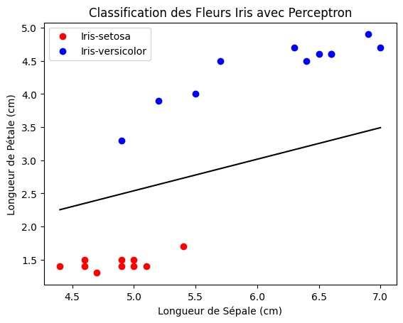
D
Resultats
B
Points on either side of this boundary are classified differently by the perceptron. For example, all points on one side of the boundary might be classified as 0, and all points on the other side as 1.
D
all points of each class lie on their correct side of the decision boundary, this means that the perceptron works well for this data

Slide 6
thank you for your kind attention

